Slide 1

Developing tools to support WZDx use
as part of
V2X Mapping Project

Slide 2

Utilizing Common Work Zone Event Data
Improved Data Specifications & Tools
Types of content needs
Develop tools to collect spatial data from the field to support work zone data collection
IOO Work Zone
Field Data Collection
Driving Task Questions
Driving Task Content Needs
Speed Limit Changes
Where am I relative to my environment?
What are the rules of the road that affect path?
What’s changed from what I already know?
Lane Closures
Data Fusion
& Decision
Signal Locations
Identify improvements to spatial data elements for work zone events
WZDI Program
Dynamic Environment Data
Work Zones
Road Furniture
WZDx Specification
Geometry Changes
Road Network
Road Usage Restrictions
Develop software translators for V2X and cooperative ADS applications
CARMA3
Signal and VMS status/translation
Notes:
Speaker Notes
As new V2X and Cooperative ADS applications emerge, there is a need to understand the changing spatial and mapping requirements for these applications.
For most of these applications, the driving task questions are the same (describes left side of graphic):
Where am I
What are the rules that affect me
What’s changed from what I already know.
Providing answers to these questions, especially in a form that is useful to a machine-driven system is a hard nut to crack.
Maps for automated vehicles are not the same as those used for traditional GIS or navigation.
Vehicles now need a combination of dynamic and static data that depicts the driving environment.
Data must allow the vehicle to understand the basic road network and the current status of its path through that network, and it must be at a very high level of precision, accuracy and currency.
Map data now refers to a real-time collection of data comprised of multiple layers and update streams.
The maps must be able to consistently and accurately describe content needs in a “computable manner” (middle of the graphic)
What is the event/object/structure being described?
Where is it located?
How good is this data?
Public sector agencies will be “one among many” types of entities making data available for AV use.
OEMs and third party data aggregators will likely also play a major role.
To gain the maximum benefit from their investment, public sector agencies will need be quite selective in the types of data that they choose to provide.
Needs to be a focus on data that clearly provides transportation safety and operational benefits and is most efficiently provided by the public sector.
Will need to agree upon a minimum national data set; develop upgraded data collection and delivery capabilities; and work to ensure that IOOs are aware of, and able to effectively implement, the core suite of standards that corresponds to the minimum national data set.
One area that seems to bring different stakeholders together is more consistent, available work zone data. There is great work being done in work zone data specification with WZDX version 2 now out and version 3 underway.
Through this effort we hope to add to the body of work by
Developing recommendations that improve the fidelity and “computability” of the spec to ADS use-cases
Developing software translators that move work zone data between various message types
Testing the utility of such data for cooperative automation.
What we are really excited about is how this graphic and the research ties together various initiatives within the USDOT. Leverages and integrates features and benefits of
CAMP WZ Mapping Toolchain
WZDx Data Specification
WZDI Framework
WZDI Data Dictionary
V2X Hub and/or CARMA Cloud
CARMA3 Vehicle
V2X Mapping Pilot Case Study and Supporting Mapping Functions & Tools
There is a demonstration of the tools developed as part of this project late-summer/fall 2020 and the software translators will be made available to the work zone community.
I’d be happy to provide more technical descriptions if you are interested. Please contact me after this meeting.

Slide 3
Expanding how WZDx Spec is used
Work Zone Data Spec
Tools to use the spec (translators, validators, data collectors)
Applications (CARMA, 511, 3rd Parties, Construction Coordination)
Improve ability of IOOs to collect more fine-grained work zone data
Improve the ability to translate work zone data to various formats for use by vehicle systems and 3rd parties

Slide 4

Focus of this toolset
Initial Work zone description (might only contain start, end, date/time)
Improved Work Zone description (lanes closed, trajectories, workers present)
Tools and Translators
Validate
Initiate
Publish
3rd parties
Applications

Slide 5
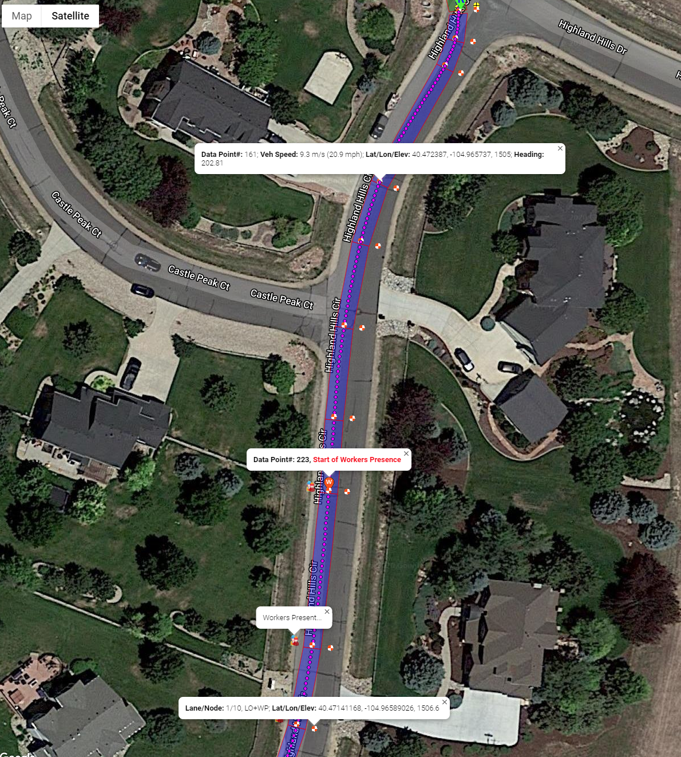
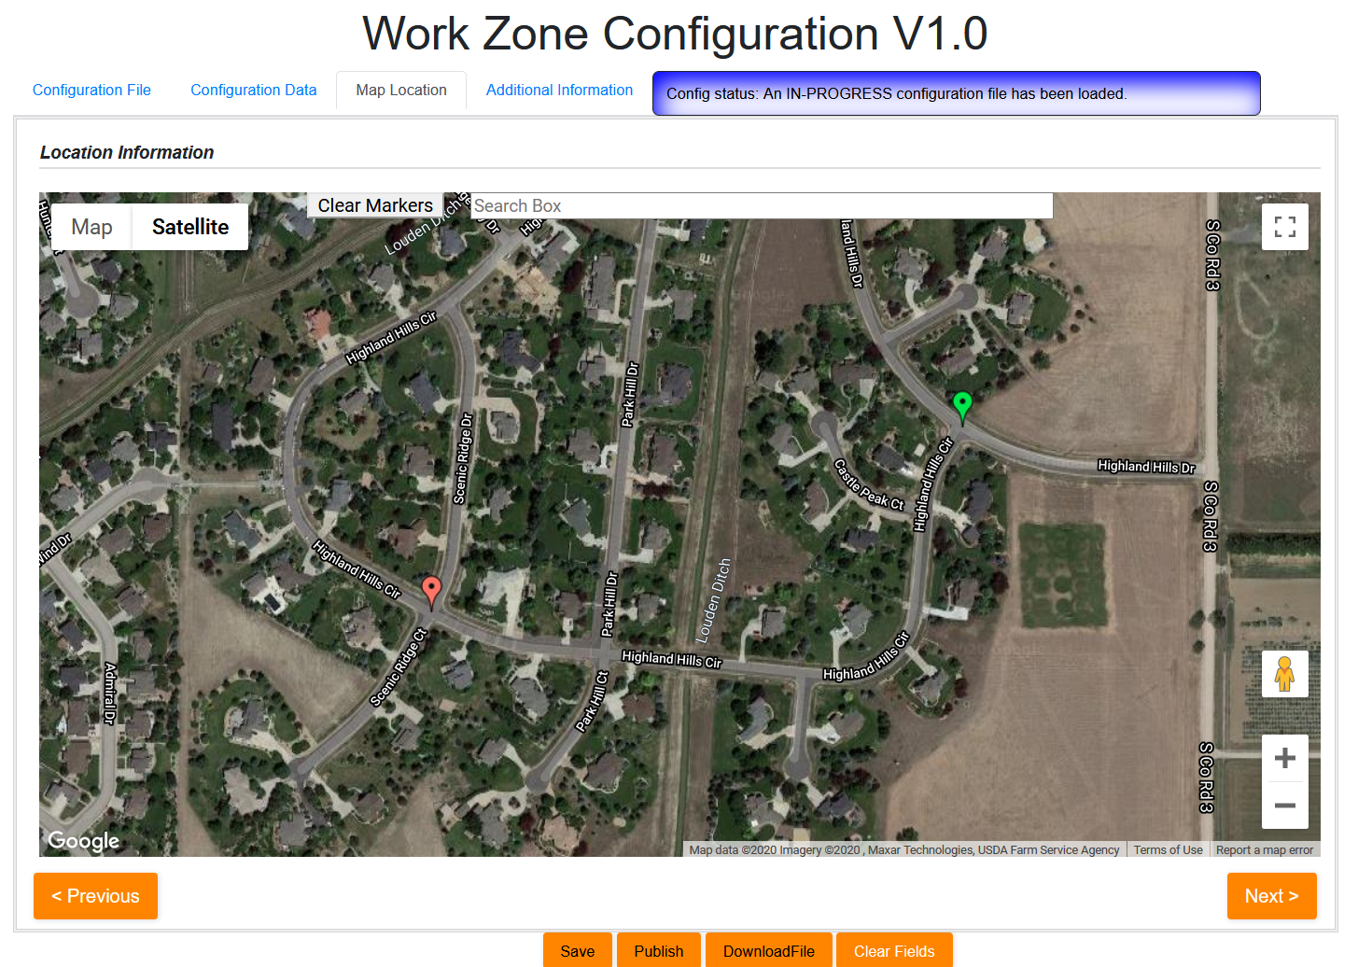
Enabling IOOs to collect WZDx in greater precision and detail

Slide 6
Toolset Capabilities (open source)
Back-office tools for TMC/IOO
Work Zone Configurator
WZDx/RSM Map Based Validator
Publish Validated WZDx and RSM to 3rd Parties
Field Data Gathering
Generate WZDx and RSM Messages
GPS Location Collection
Receive/Send Files with Cloud

Slide 7
Likely Users of Toolset
Likely users
Work Zone Data Spec
Tools to use the spec (translators, validators, data collectors)
Applications (CARMA, 511, 3rd Parties, Construction Coordination)
Work Zone Data Translators (RSM to WZDx, WZDx to OpenDrive)
CAV Community
Back Office Configuration Tools
ATMS Vendors
Field Data Collection
Smart Work Zone, Construction crews, HD Mapping companies

Slide 8
Leverages Precursor Toolsets
Upcoming RSM standard
CAMP tool
RSM to WZDx translator
WZDx Spec

Slide 9
Demonstration

Slide 10
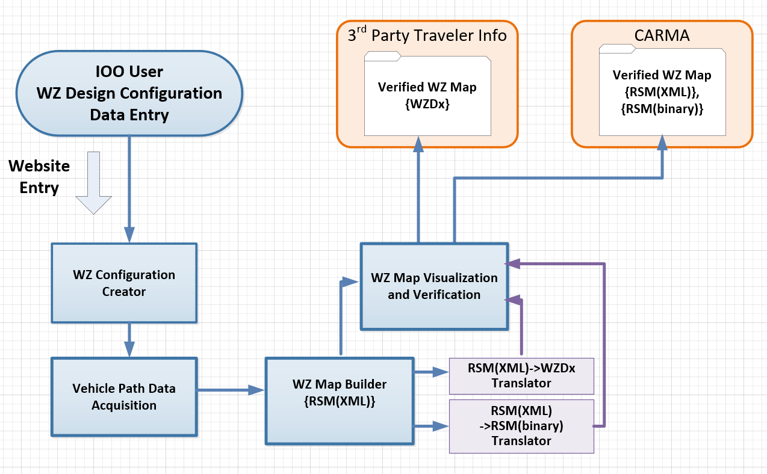
High Level Tools Workflow

Slide 11
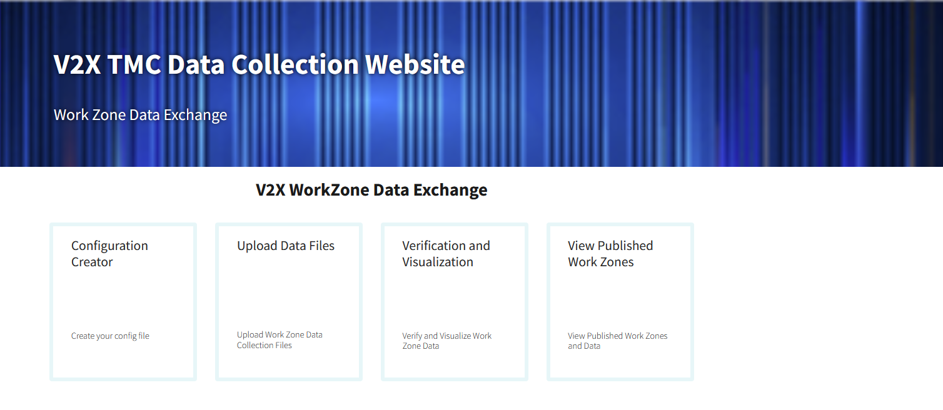
Back-Office Toolset

Slide 12
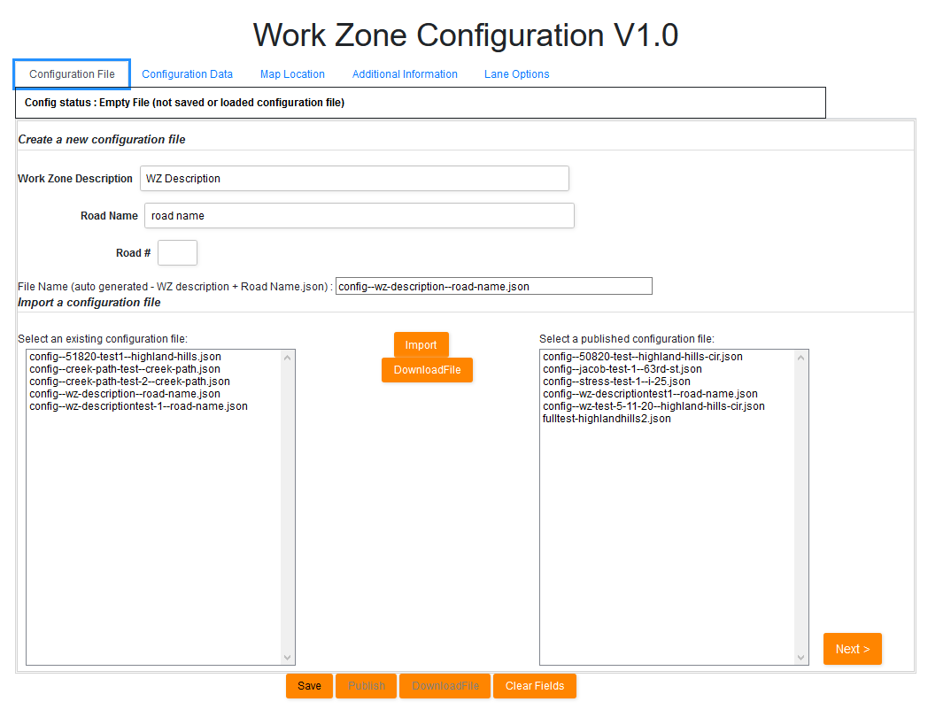
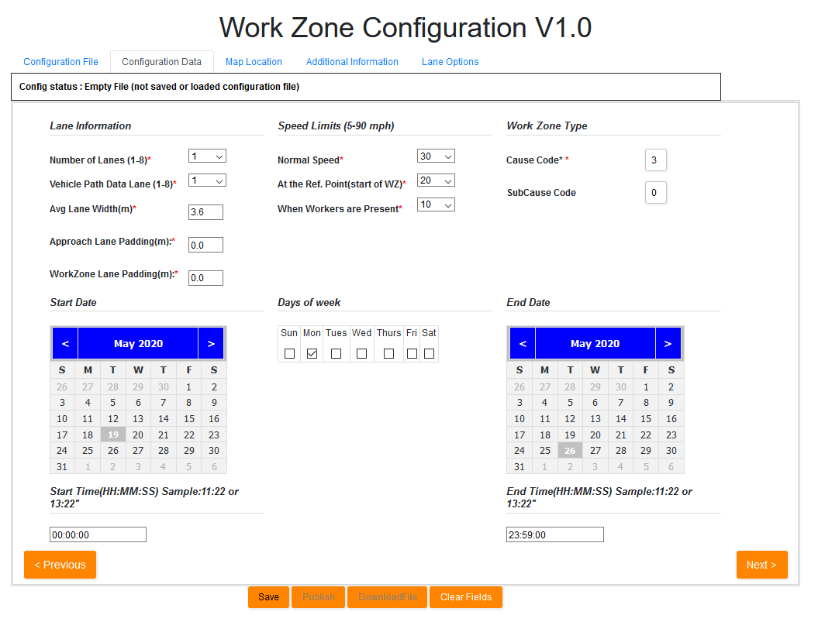
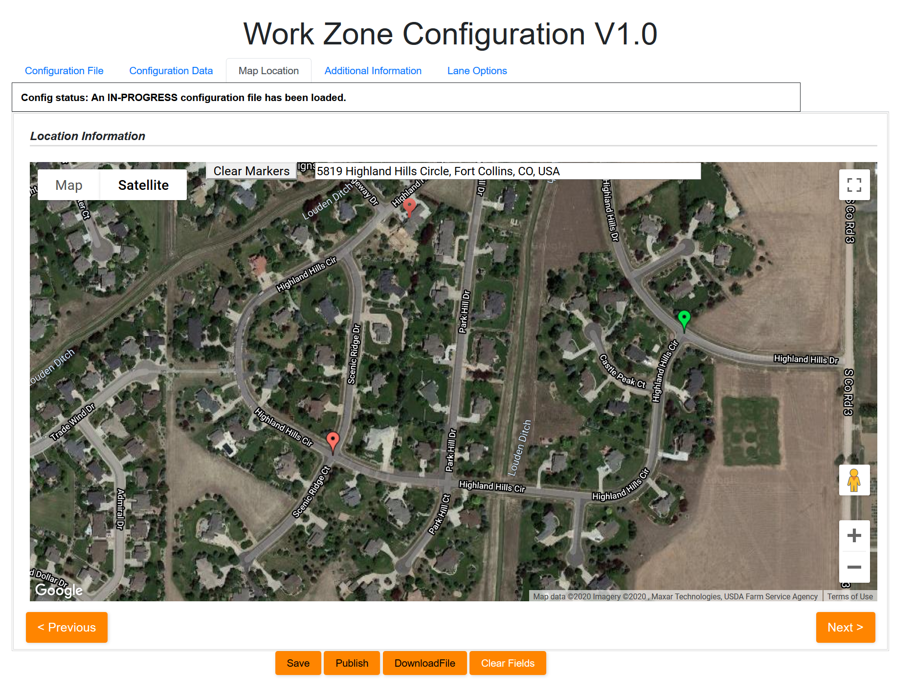
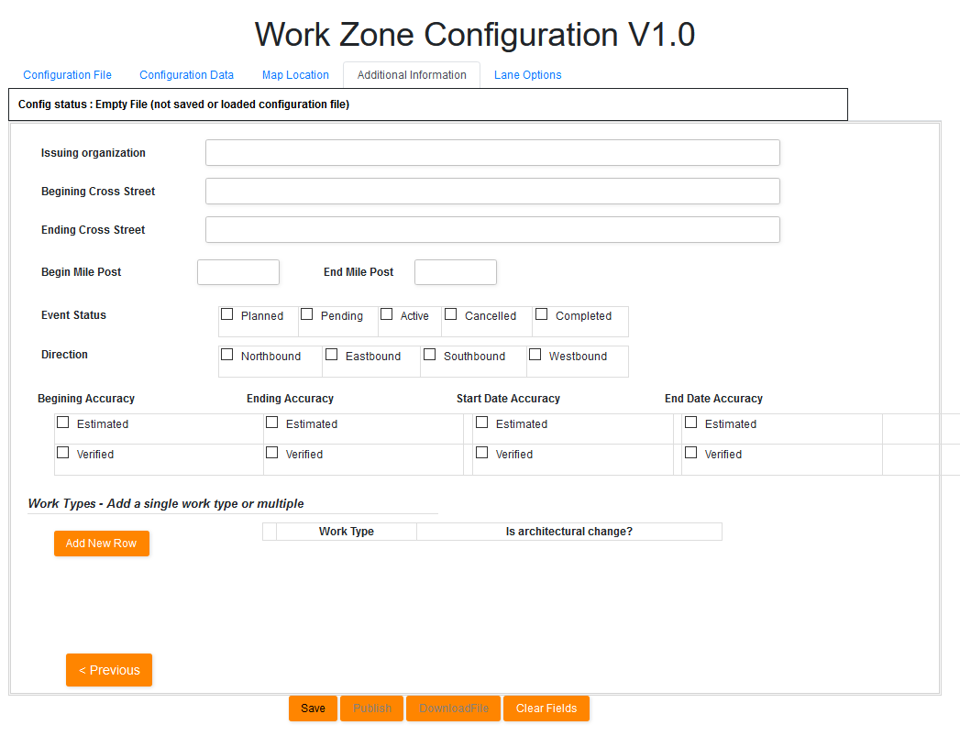
TMC Operator/IOOs enter basic information about work zone
Data is consistent with WZDx spec v2.0
Minimum information required
Begin/End location
Date/Time
# Lanes
Speed Limits
.

Slide 13
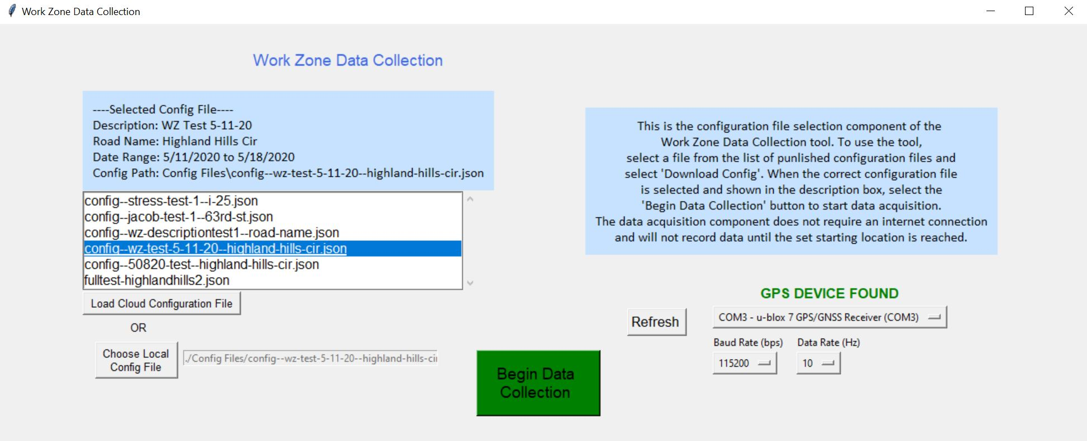
Field Data Collection Tool (Persona: Work Zone Manager)
Field vehicle receives information (via cloud, via RSU)
Download published configuration files
Automatically detect GPS device

Slide 14
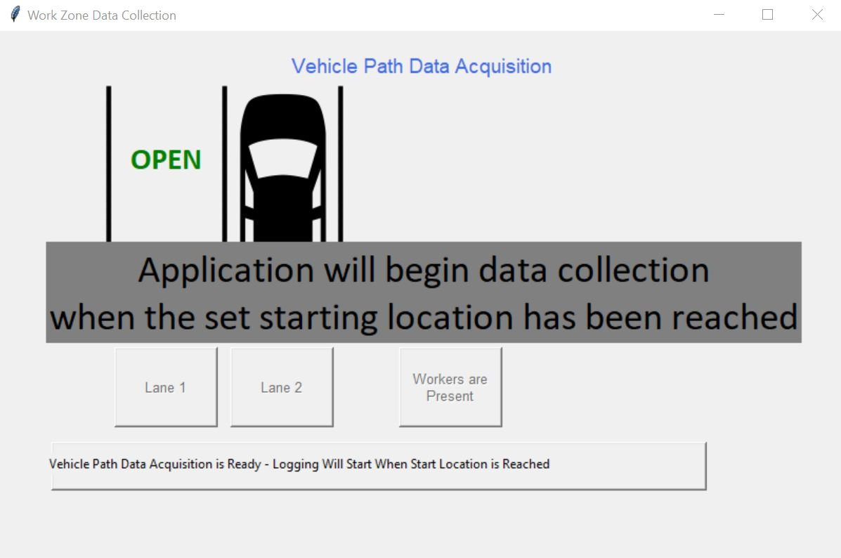
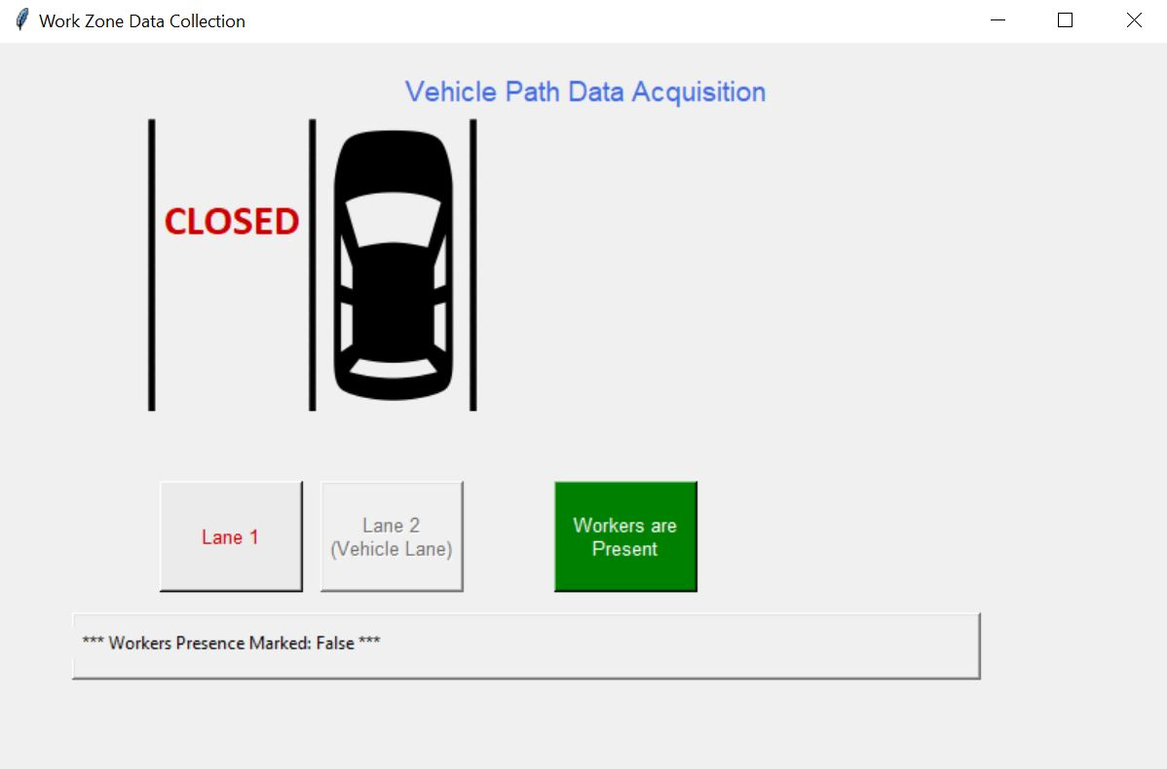
Field Data Collection Tool
Data collection automatically starts/ends when set starting/ending locations are reached
User interface to select current state of road/work zone

Slide 15
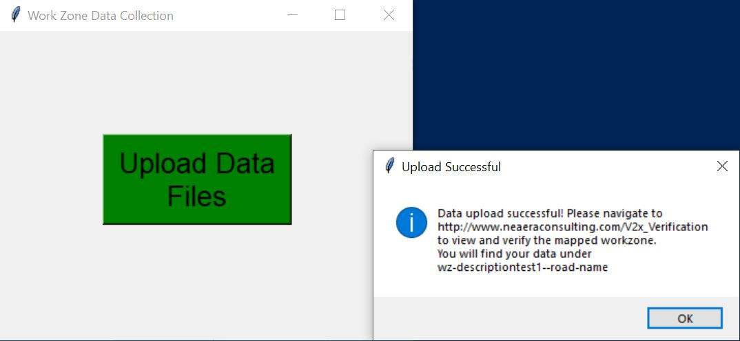
Field Data Collection Tool (Upload)
When the work zone has been mapped, the path history data is compressed/reduced and messages are created (WZDx and RSM) automatically
RSM (XML) Message is converted into binary (UPER) automatically
Messages and path data are zipped and uploaded to the back-office

Slide 16
Received information is used to generate a work zone with new geospatial details in the back office (cloud) for validation
Overlay WZ Map information
Work zone data points
Compressed data points (updated to use breadcrumb from SAE J2945/1 spec)
Worker presence
Lane closures
Approximate lane locations
TMC Operator verifies accuracy of recorded work zone
TMC Operator publish verified work zones available for
3rd party (SDX, WZDx, WAZE, HERE)
511
CARMA and other cooperative automation applications

Slide 17
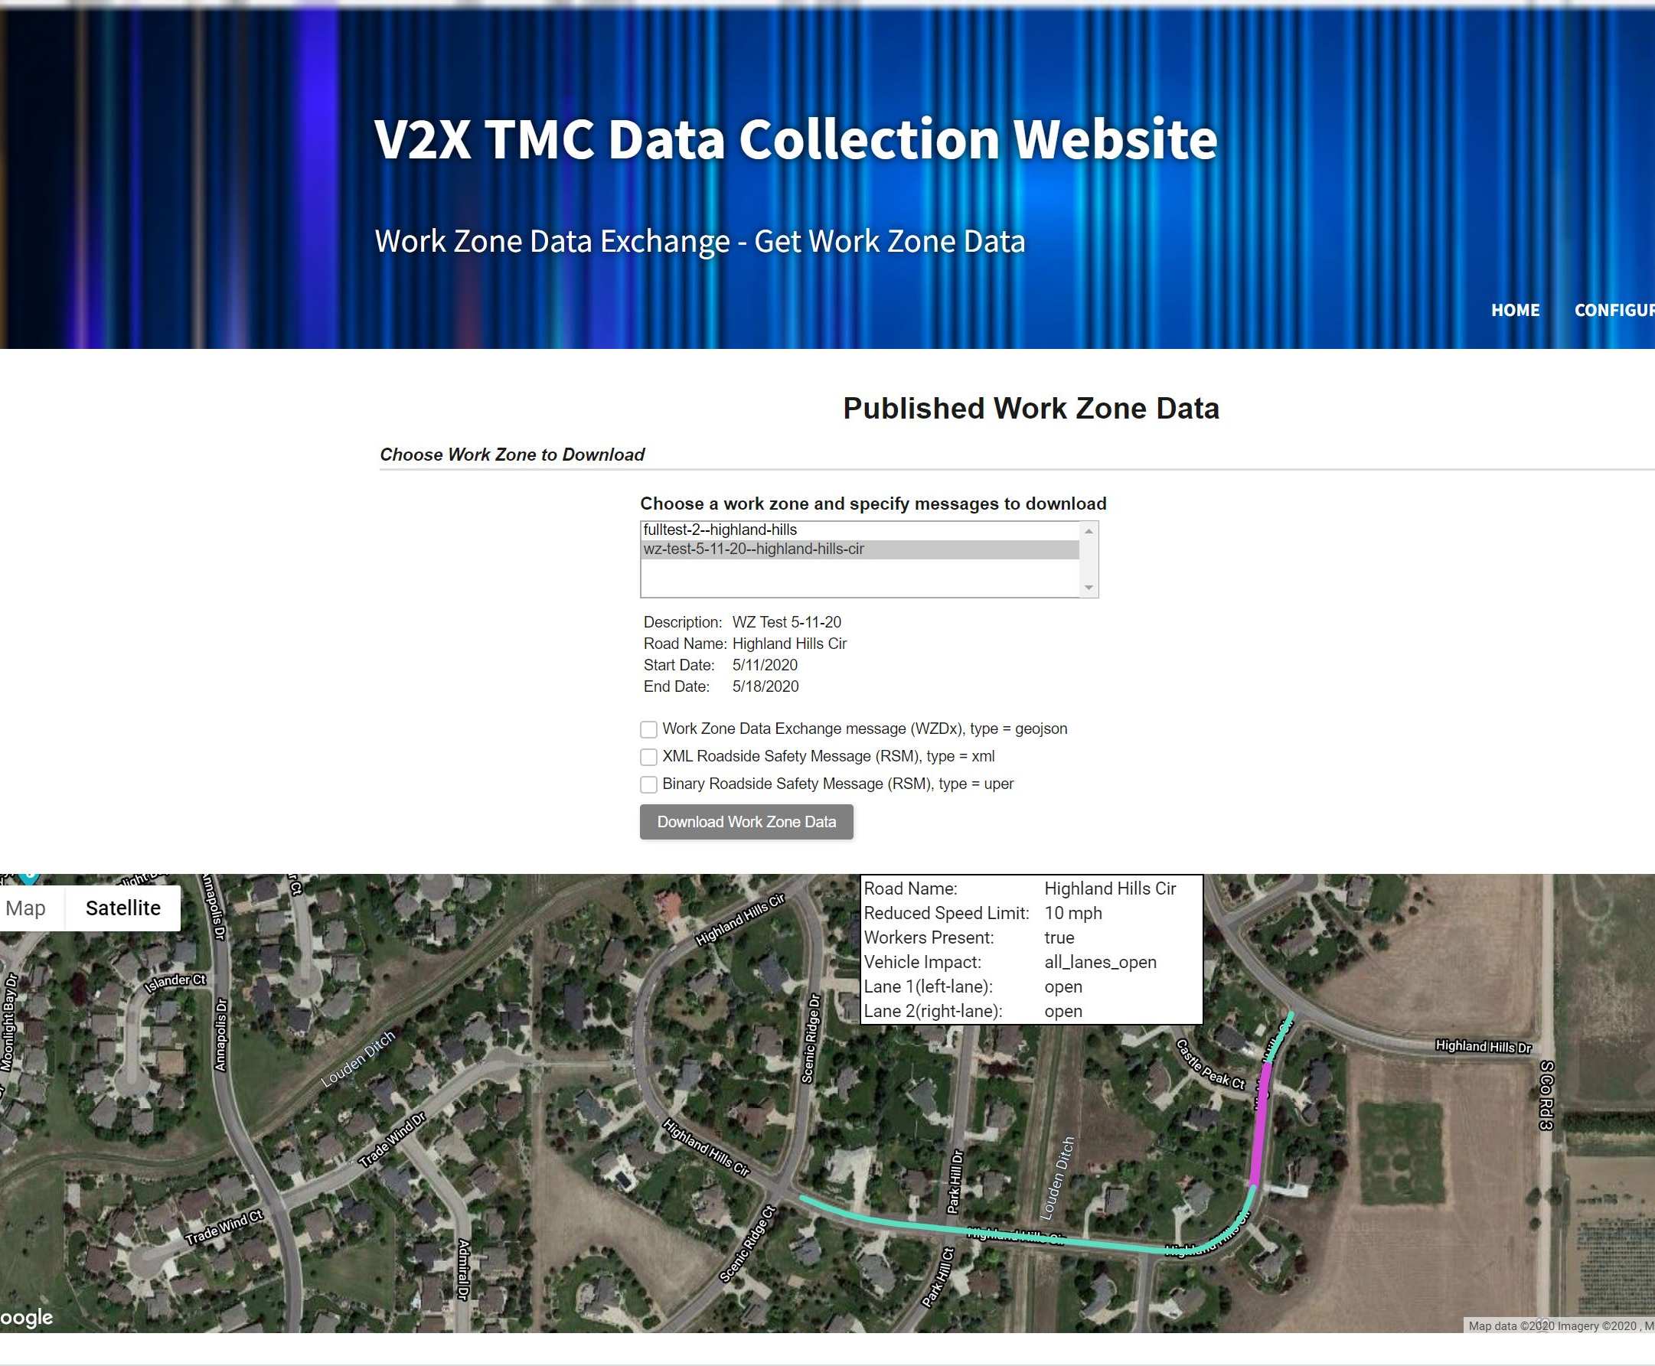
Published Work Zones
View published work zones
Download published work zone data (WZDx, RSM-XML, RSM-UPER)

Slide 18
Future Enhancement Possibilities
Mobile app (iPhone/Android)
Message generation in the cloud
Move translator from vehicle to cloud
ASN1.c open source encoder/decoder for RSM
V2X-Hub integration with RSU/OBU for message upload/download
Auto detect:
Workers (DNN/CNN)
Lanes open/closed (OpenCV)
Road signs (DNN/CNN)
Website:
https://neaeraconsulting.com/V2x_Home
GitHub site:
https://github.com/TonyEnglish/V2X-manual-data-collection
Full end to end test video:
https://youtu.be/BCNGWHPjjjo

